Slide 1
Game of Life
Massive actor to actor communication in Service Fabric

Slide 2
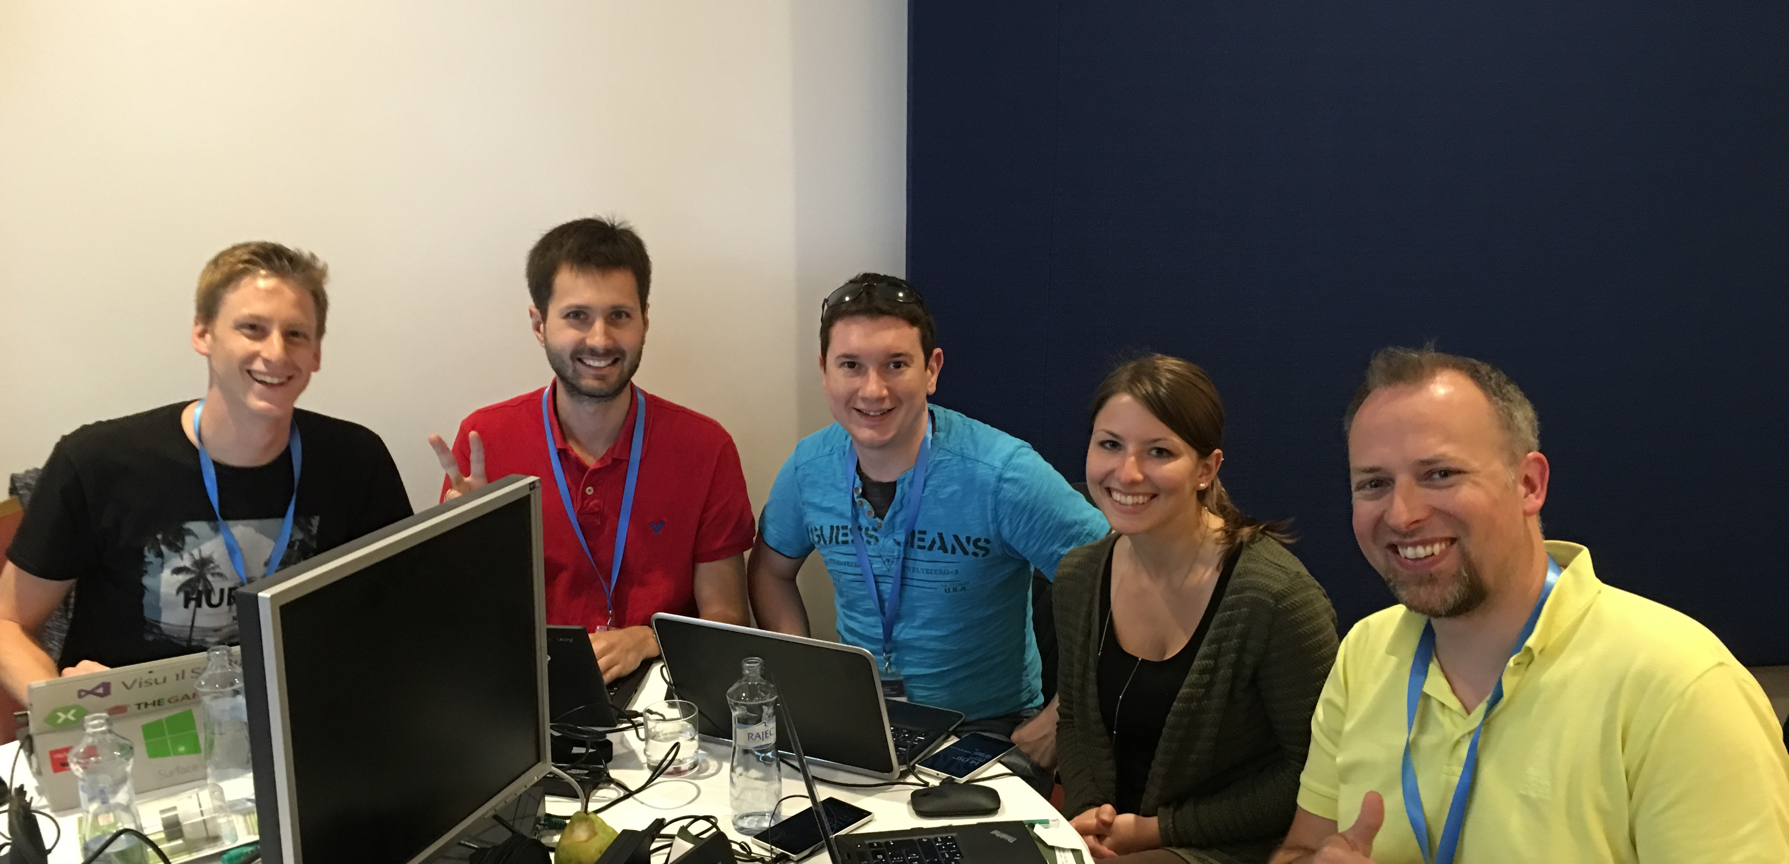





The Team of Hackers
Sebastian
Peter
Malte
Julia
Daniel

Slide 3
Game of Life - The Rules
For a space that is 'populated':
Each cell with one or no neighbors dies, as if by solitude.
Each cell with four or more neighbors dies, as if by overpopulation.
Each cell with two or three neighbors survives.
For a space that is 'empty' or 'unpopulated'
Each cell with three neighbors becomes populated.

Slide 4
Cells live and die
Alive
Pre Alive
Dead

Slide 5
Cells live and die
Alive
Pre Alive
Dead

Slide 6
Cells live and die
Alive
Pre Alive
Dead

Slide 7
Demo

